Slide 1
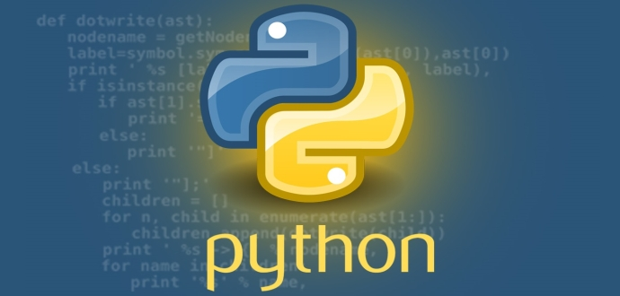
Welcome
Introduction to Python Programming

Slide 2
Schedule
09:00 - 09:15 Introductions
09:15 - 09:45 Numbers, Text, Boolean - Exercise 1
09:45 - 10:30 Casting, Variable Assignment, Lists, Tuples - Exercise 2 and 3
10:30 - 11:00 Dictionaries – Exercise 4
11:00 - 11:15 Break
11:15 - 11:45 Sequence, Selection, Iteration – Exercise 5
11:45 - 12:00 Catch up time
12:00 - 12:30 Functions/Parameters
12:30 - 01:15 Lunch
01:15 - Afternoon work through exercises on pandas dataframe/titanic dataset

Slide 3
Python Online
Good for simulating scripts (lines of code)
https://repl.it/repls/OnerlookedBestWrapper
Good for visualising execution of iteration
http://pythontutor.com/visualize.html#mode=edit
This is fast and reliable (a bit tested by me)
https://www.python.org/shell/
To open titanic.csv from github put in the following code
Import pandas as pd
url='https://raw.githubusercontent.com/salihadfid1/Intro-Python/master/titanic.csv’
df = pd.read_csv(url, index_col=0)

Slide 4
Why learn Python?
Well loved by all - WHY ?
A high-level language and can do complex tasks. For example, Web Development, data analysis, artificial intelligence, games, desktop apps.
Loads of resources (libraries)/materials/support to help you develop.
Python is easy to learn and has a clean syntax.

